Slide 1
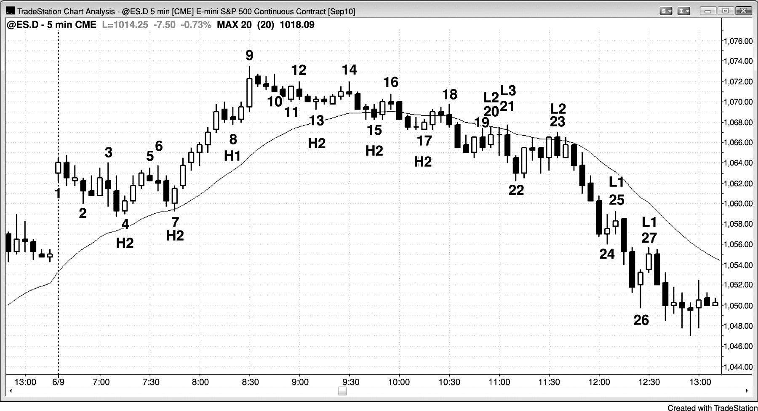
FIGURE 17.1 Bar Counting

Slide 2
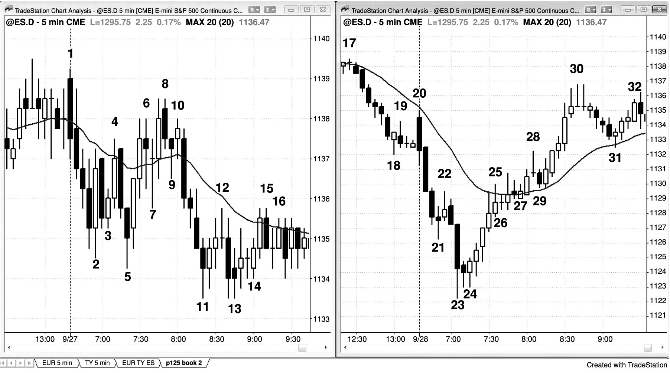
FIGURE 17.2 High and Low 1 Setups in Trading Ranges

Slide 3
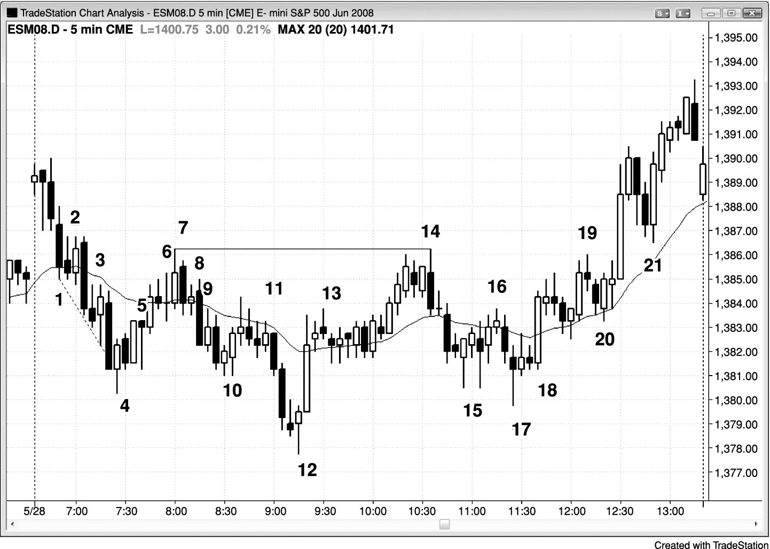
FIGURE 17.3 Bar Counting Is Sometimes Difficult

Slide 4
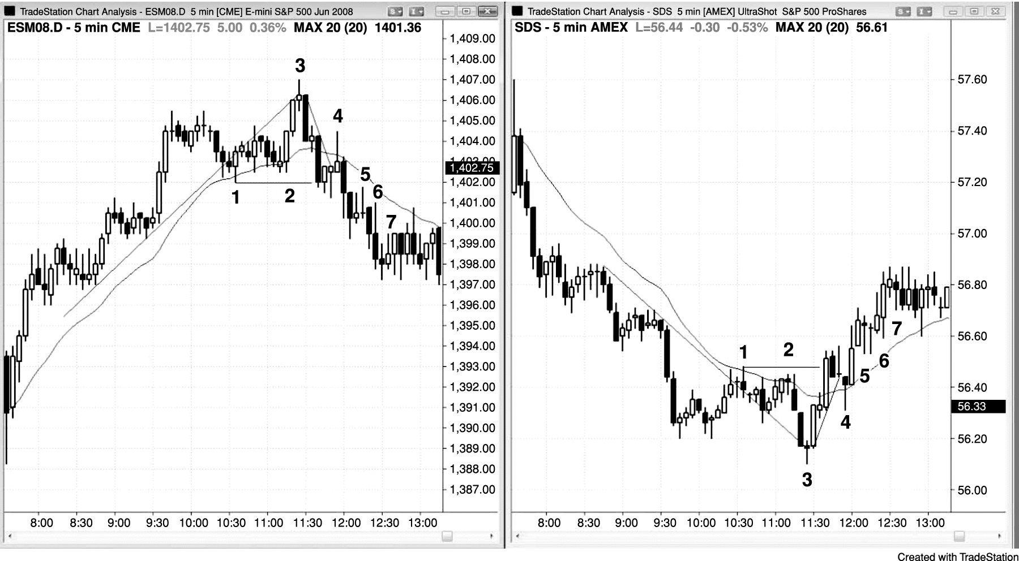
FIGURE 17.4 The SDS Is Helpful in Analyzing the SPY

Slide 5
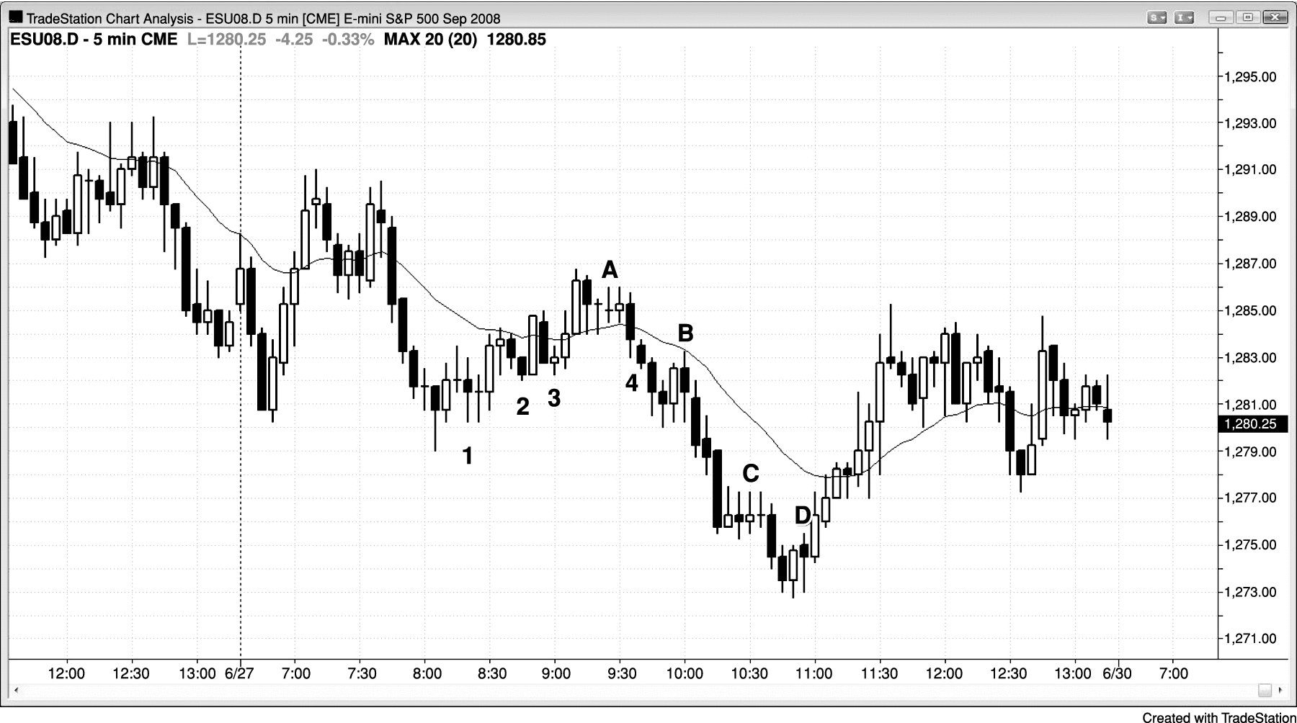
FIGURE 17.5 A Failed Low 2 Often Ends Up as a Low 4 Short

Slide 6
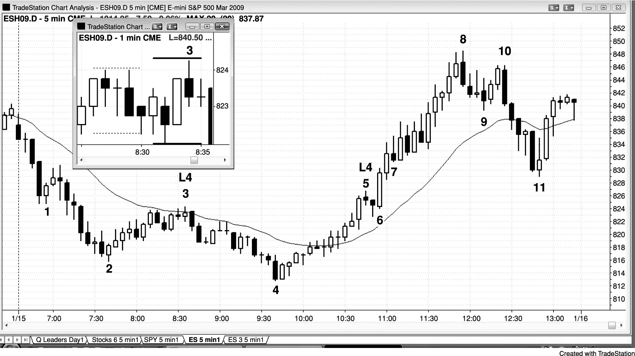
FIGURE 17.6 Failed Low 4

Slide 7
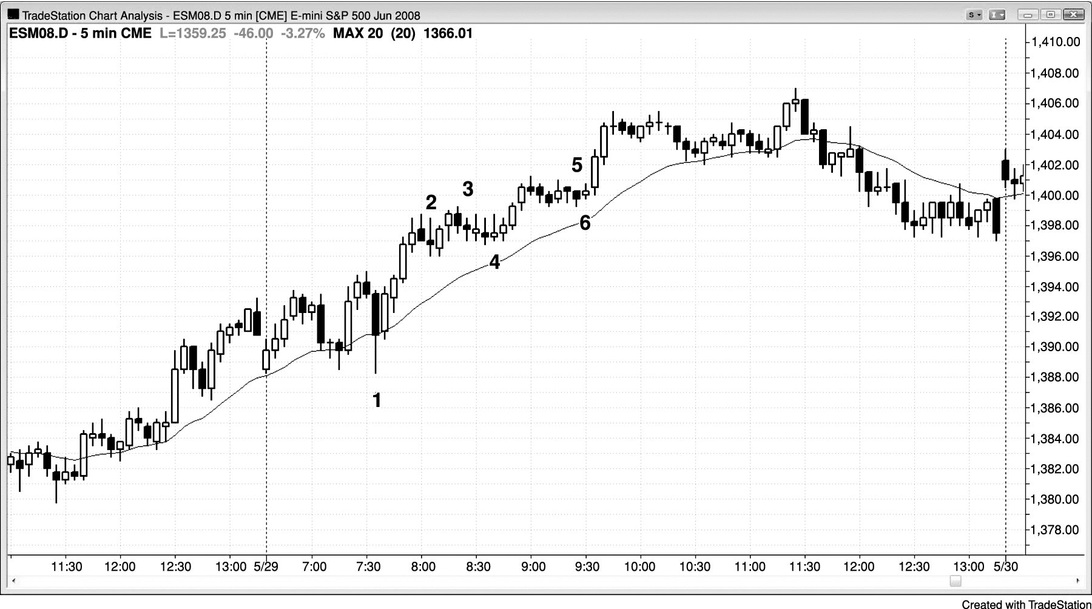
FIGURE 17.7 A Low 2 in a Bull Trend Is Not a Short

Slide 8
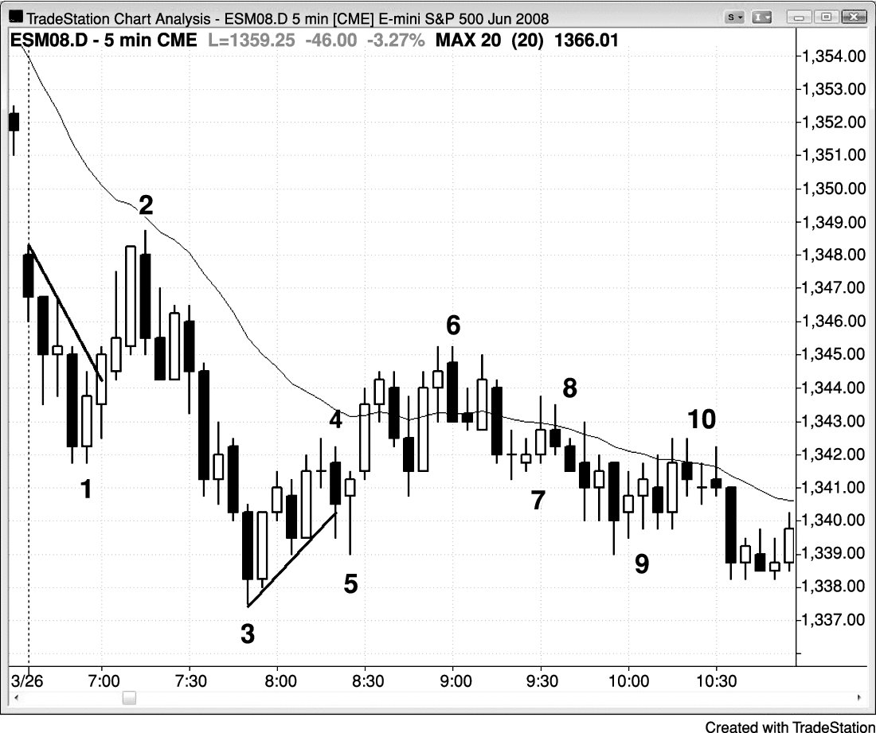
FIGURE 17.8 Failed Low 2

Slide 9
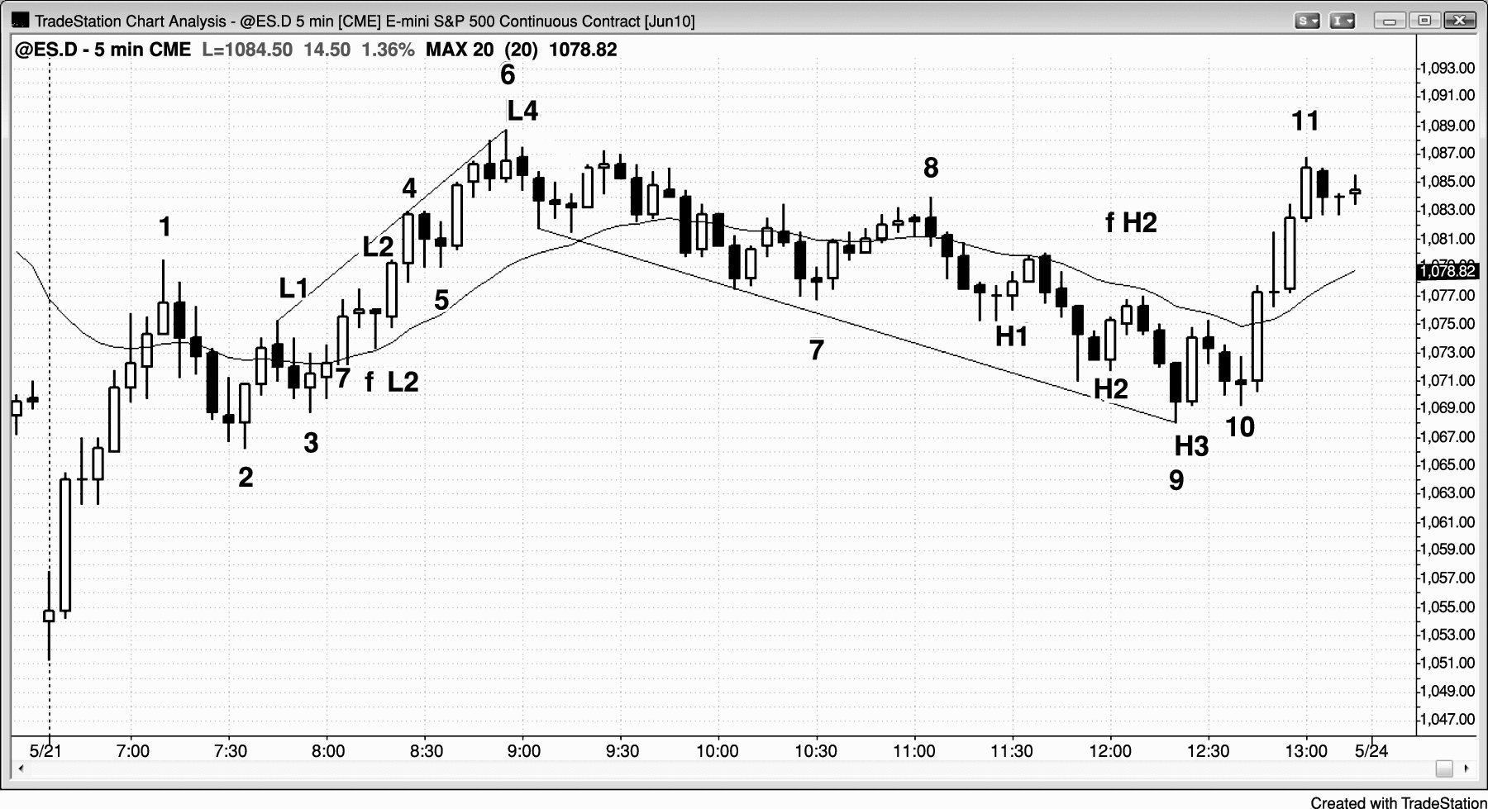
FIGURE 17.9 A Failed Low 2 Can Evolve into a Low 3 or Low 4

Slide 10
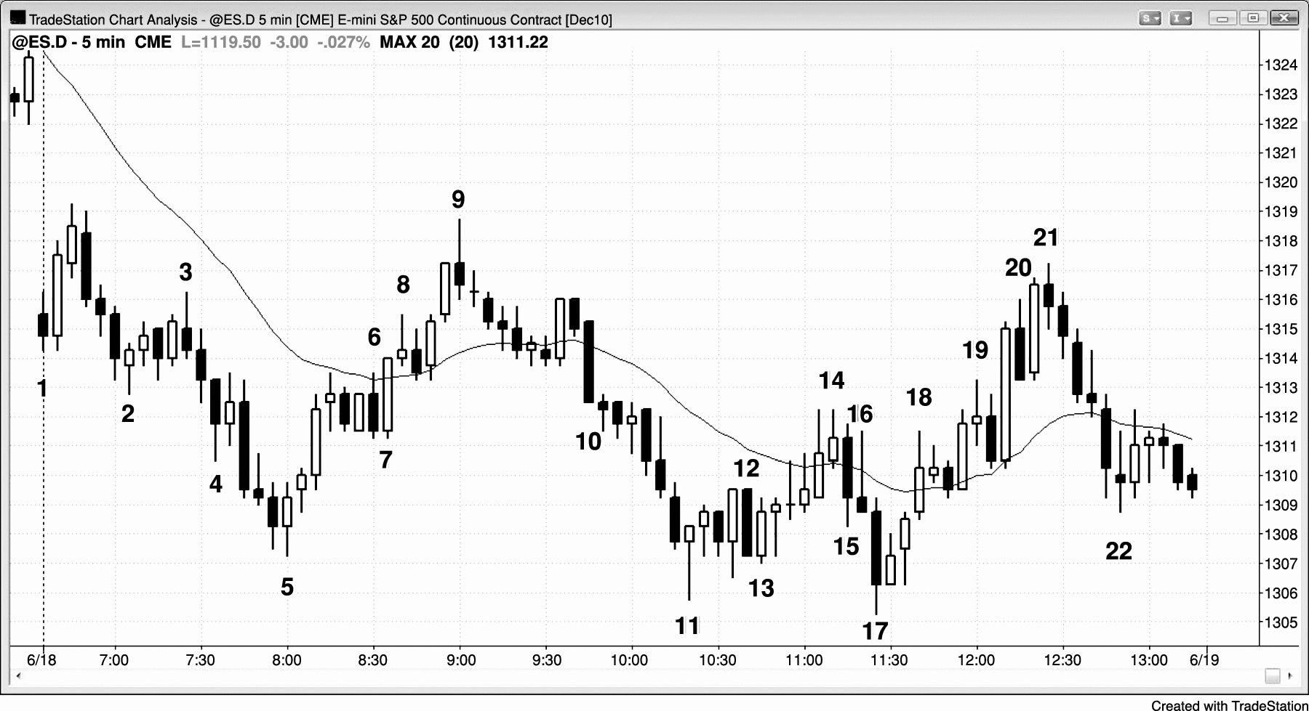
FIGURE 17.10 High 2 Variant

Slide 11
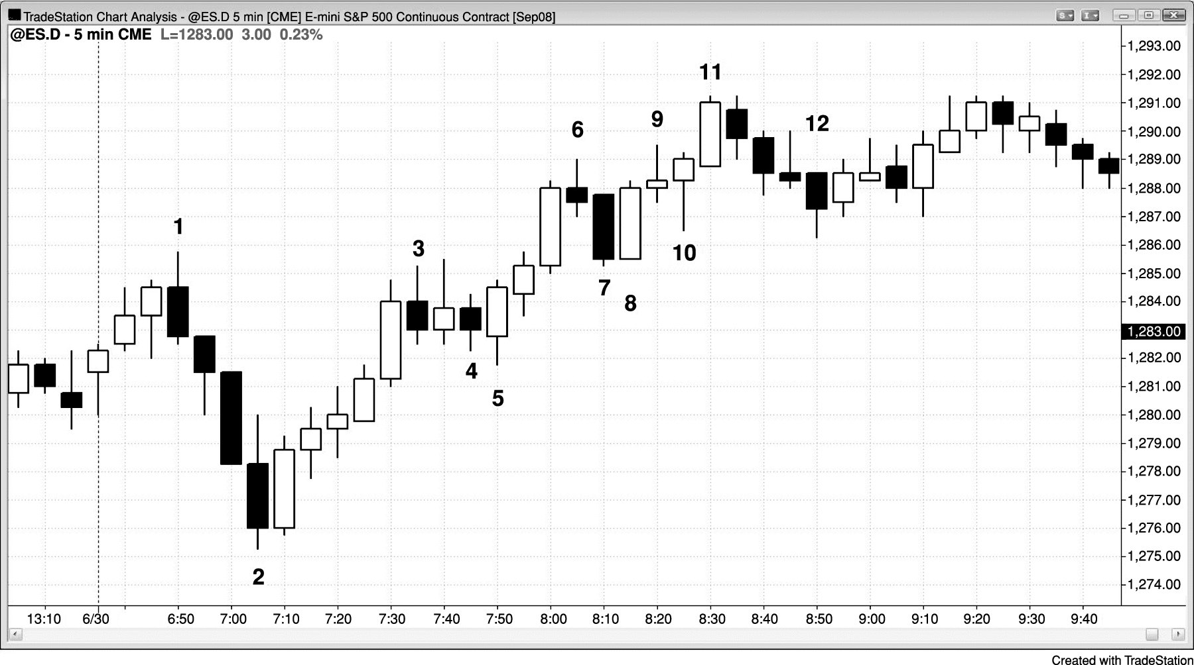
FIGURE 17.11 High 2 Variant

Slide 12
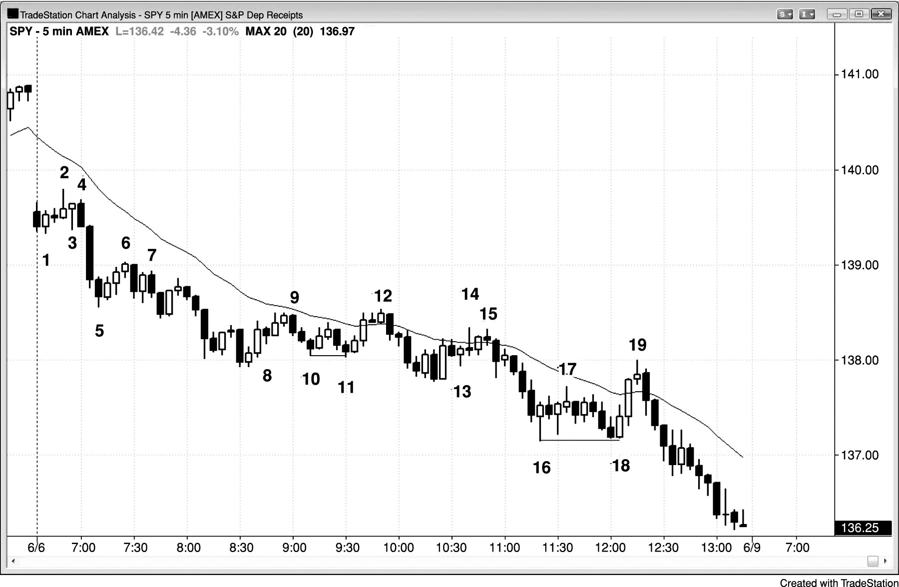
FIGURE 17.12 Low 2 Variants

Slide 13
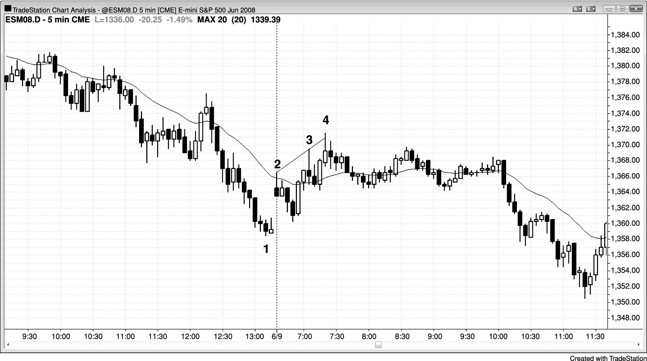
FIGURE 17.13 A Spike and Channel Is a Two-Legged Move

